Slide 1
Putt Putt Golf Site Development
Eighth Wonder
Lane Barnes - Authentication and Testing
Evelyn Teeples - Scrum Master
Josh Williams - Site Design and Documentation
Eathan Hodgkinson - Site Design and Database Models
Carter Parks - Database Modeling and Developer

Slide 2
Overview
This project was created to help run and manage a Putt Putt Golf tournament. The four types of users that can use our application are players, managers, sponsors, and drinkmeisters.
A player can play in a tournament and the application will help track their hole and score.
A manager verifies users as well as edits tournaments and the drink menu.
A sponsor can donate money to sponsor a tournament and that tournament will be named by their company.
A drinkmeister makes and delivers drinks. The application helps manage orders, drink recipes, and delivery locations for the drinkmeister.
All users can order drinks and add money to their accounts.

Slide 3
Major Design Decisions
The major design decisions for our project were: what platform to build our application in, how to share our code, how we should communicate as a group, what coding languages to use for development, and how the application should look when it was finished.
We decided to build our application using Django since it was relatively easy to learn and most of our team had used it before. Django also has very professional and easy to read documentation which was another major reason for choosing Django.
For sharing our code between group members we decided to use Git because it was strongly suggested by the project owner and most of our team was familiar with it. Git allowed all of us to work on the project at the same time without issue which allowed us to break our project down into manageable pieces.

Slide 4
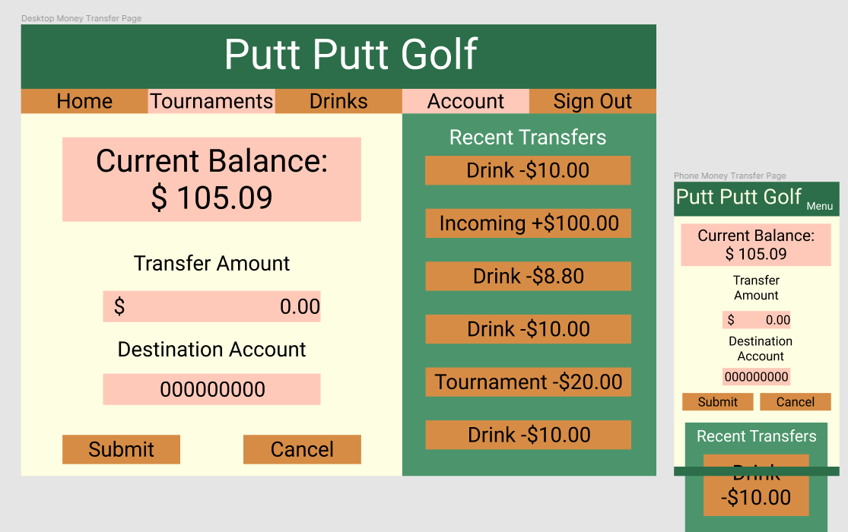
Major Design Decisions
To communicate with each other we decided to use Discord because all of us knew how to use it and Discord is fantastic for communication. We could text or call in Discord and if someone had a coding problem they could share their screen and get help.
We decided to write our code using Python, HTML, and CSS because our team collectively decided those were our strongest languages and Django uses python so it made it an easy decision for us.
The last design decision we made was about how our application was going to look when it was finished. We decided to go with a green and orange color scheme because it looked nice and had a Putt Putt Golf feel to it.

Slide 5
Agile Practices
Our first week as a team was a bit of a disaster because we did not have any agile practices put in place but once we did our productivity began to increase. We started meeting almost every week day and we started breaking down large tasks into smaller pieces so multiple people could work on them. We found that meeting more often helped keep us on track since we were constantly reporting to each other. Breaking down these large tasks helped lessen the anxiety associated with them. We also started using Trello to assign tasks to different group members and that allowed us to constantly know what we had to get done and what everyone else was working on.

Slide 6
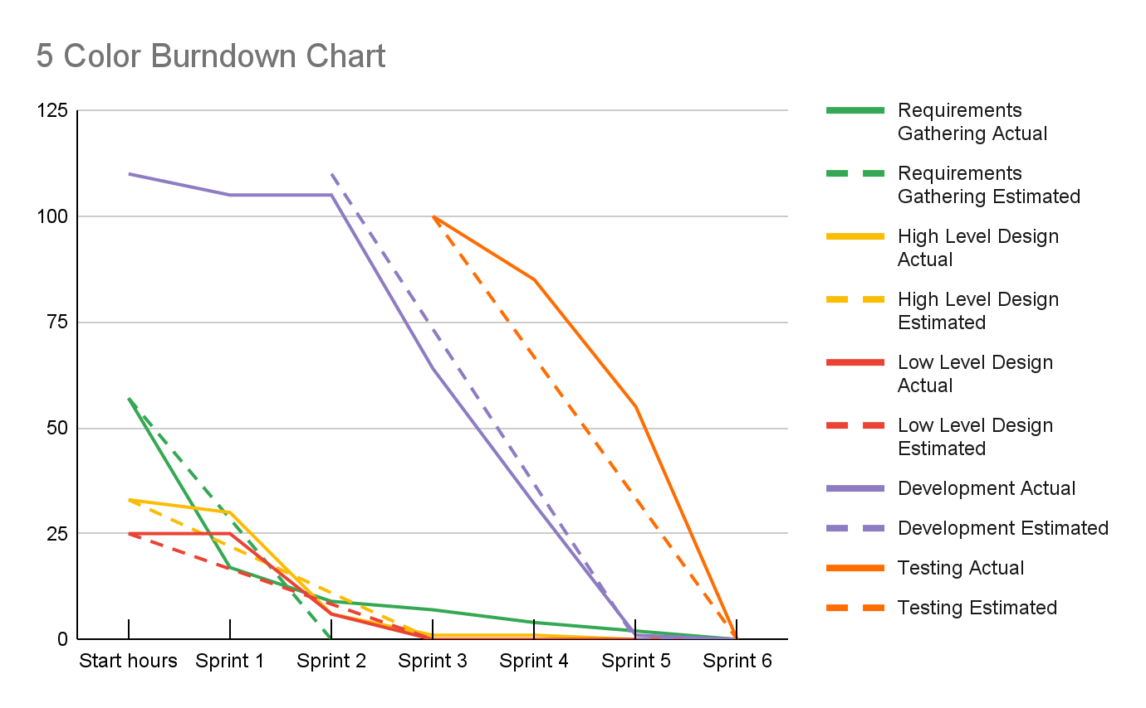

Slide 7
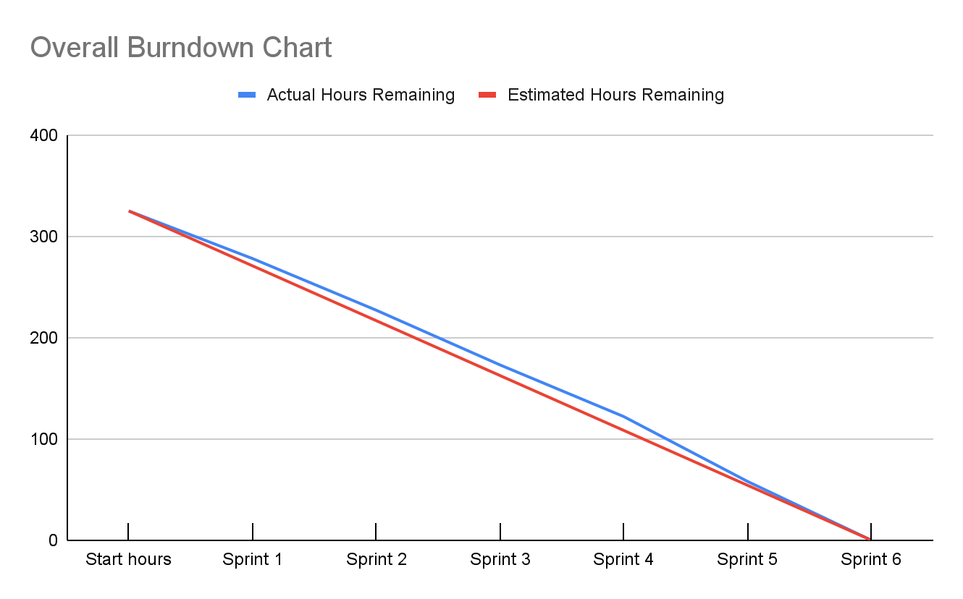

Slide 8
Deployment
The deployment process for the site is as follows:
After all pull requests are merged, and testing is complete, the server is launched from the AWS EC2 console.
After connecting to the server, which runs Ubuntu 20.04.2 LTS, changes to the software are manually pulled from the Github repo where they are stored.
A series of tools provided by Django are used to perform the following steps.
Changes to the database schema are implemented by running a command which compiles the various changes to the Django models into a migration (a slice of the history of the schema), then by migrating these slices to the database.
The database is a MySQL database handled entirely through Django’s tools.
Static files (Javascript, CSS, images) are collected into a single location for easier access by Django.
Nginx is launched as a system service, along with gunicorn_start, a shell script to run Gunicorn with a series of presets.
Gunicorn is a Web Server Gateway Interface HTTP server written in Python, which allows for multiple worker processes (4 in our case) to serve requests, unlike Django’s development mode.
Nginx is a web server with a variety of features, similar to Apache, but with better performance. It interfaces with Gunicorn, which in turn interfaces with Django, to provide security and scalability.
After these steps have been completed, the site is up and running on port 80 at whichever URL points to the server.

Slide 9
Testing
The majority of our testing was done by us as the developers through manual testing. When we wrote any new feature we would test it on the website immediately to make sure it was working correctly. If the new feature did not work as intended we knew right away and began fixing it.
The other type of testing we did was unit testing for our models and to do this we used Django’s built in testing library. We were able to program Django to create our models with very specific information and then we had Django query the database to ensure those models were stored just as intended. Our testing showed that our models were being created and saved to the database correctly.

Slide 10
Requirement - User Authentication
FURPS
Functionality
Each user must have a unique username; although, duplicate emails are allowed
The user must be able to select their own user type while creating an account
When a user logs in they will be able to see information relevant to their user type.
Usability
Anyone visiting the application is able to make an account.
Anyone can log in to an existing account if they have the correct information
Performance
Creating or Logging in to an account should not affect the overall performance of our application
Supportability
A user should be able to create or log in to an account on virtually any device that can access our application
Audience-oriented
Business Requirements
A user has to be authenticated to buy anything.
User Requirements
Logging in and creating an account are simple straightforward processes
Non-functional Requirements
The account creation page will tell the user when they are missing required information.
The login page will tell the user if the information they input is incorrect.
Functional Requirements
A user must be added to the database when an account is created
Implementation Requirements
The application must be connected to the database for any authentication to occur
MOSCOW
Must
A user must be able to log in to an existing account
A user must be able to create an account.
Each account must have a user type
Should
A user should be able to view pieces of the website without being authenticated
Could
A user could have a different account creation process based on the user type they selected.
Won’t
A user won’t be able to make an account if their username is already taken
A user won’t be able to retrieve their password if they forget it.

Slide 11
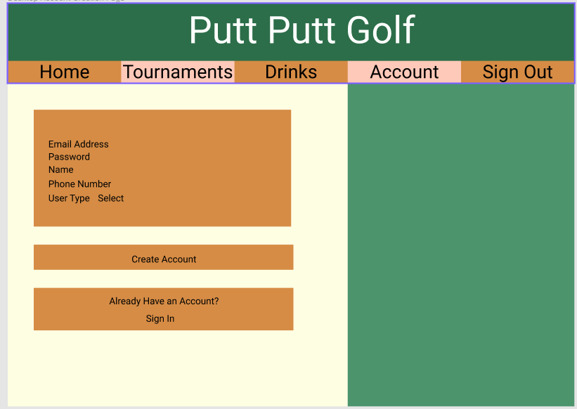
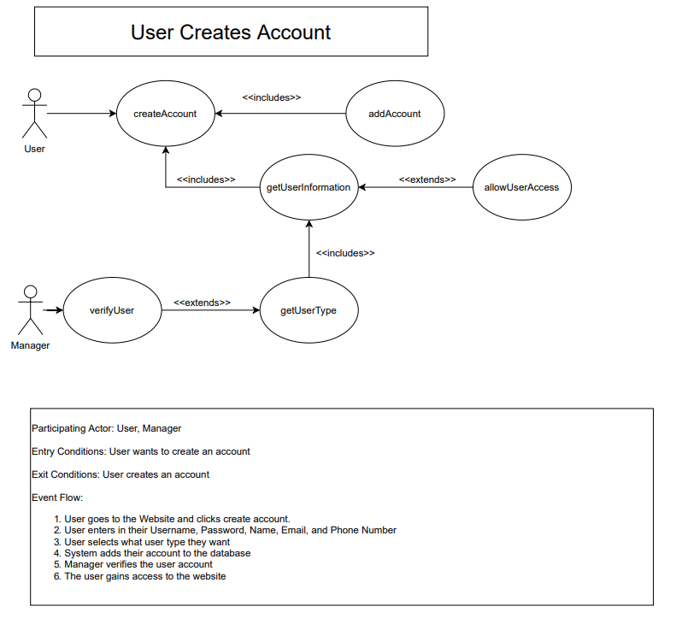
Requirement - User Authentication
To create an account the user needs to input all of their relevant information and click create account.
If any needed information was left blank then the application will tell the user what needs to be filled in.
If account creation was successful then the user can login with their username and password. The user’s account is now stored in the database
Any managers will now be able to verify the user’s new account if the account type was a drinkmeister or sponsor.
Prototype Design
Use Case Diagram

Slide 12
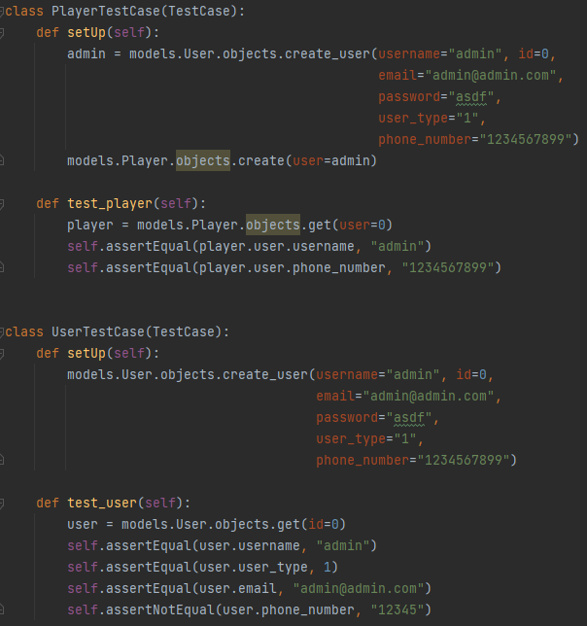
Requirement - User Authentication
The main tasks associated with developing this feature were creating an account and being able to log in to an account.
These two tasks were completed by Lane and testing for this feature was done with unit testing and manual testing.
The unit tests created models with known information and then queried the database to ensure those values were correct.
The manual tests involved creating users with varying information on the application and then logging in to the database to ensure that everything was saving correctly.

Slide 13
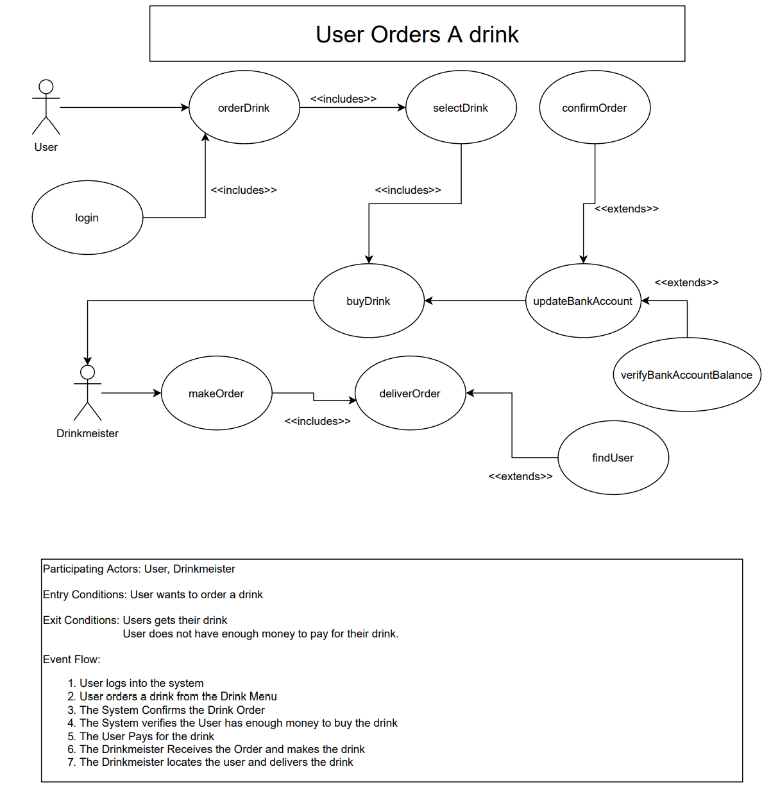
Requirement - Drink Meister
FURPS
Functionality
There may be multiple Drink Meisters, Drinks, and Orders.
The manager must be able to add, edit, or delete drinks from their account.
Any user may order a drink if they have enough money in their account.
The Drink Meister must be able to see all the orders from all users and be able to deliver and finish the orders.
Usability
The drinks may be able be ordered by any user.
The Drink Meister can deliver the orders.
Performance
The site is hosted on AWS and there isn’t likely any performance issues affecting the Drink Meister.
Supportability
This app should be accessible to virtually any device that has internet and browsing capabilities.
Audience-oriented
Business Requirements
The Manager can control the drinks and orders.
Drink Meisters have their own employee profiles and privileges.
User Requirements
The app is simple and user friendly for users to order drinks.
Managers and Drink Meisters are also easily able to accomplish their tasks.
Non-functional Requirements
The interface for the drinks and Drink Meister is simple and easy to use.
Functional Requirements
There may be multiple Drink Meisters, Drinks, and Orders.
The manager must be able to add, edit, or delete drinks from their account.
Any user may order a drink if they have enough money in their account.
The Drink Meister must be able to see all the orders from their account and be able to deliver and finish the orders.
Implementation Requirements
Drinks and locations must be created before drinks may be ordered.
MOSCOW
Must
The manager must be able to add, edit, or delete drinks from their account.
The Drink Meister must be able to see all the orders from all accounts and be able to deliver and finish the orders.
Should
The users should be able to order any of the drinks in any quantity that they want given that they have the funds.
The orders should include a delivery location and personalized instructions.
Could
Won’t
Use Case Diagram

Slide 14
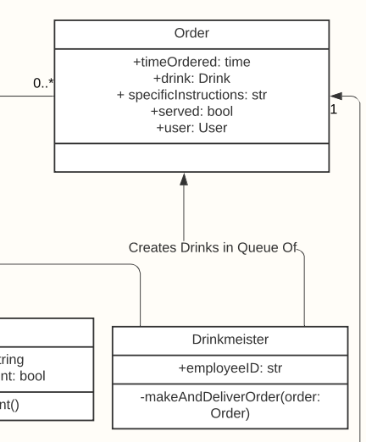
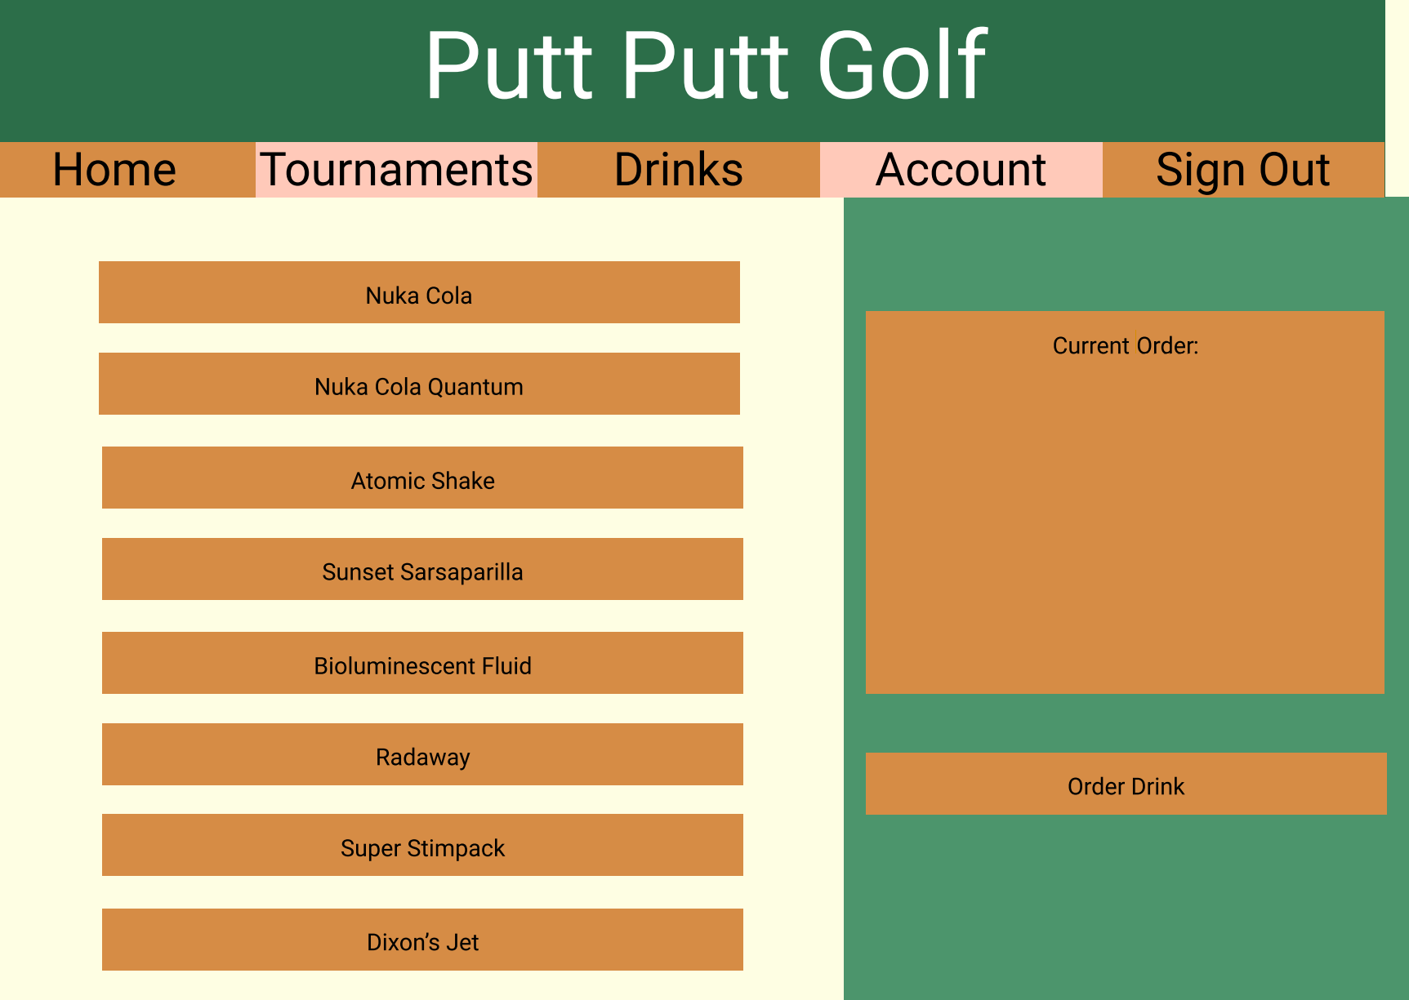
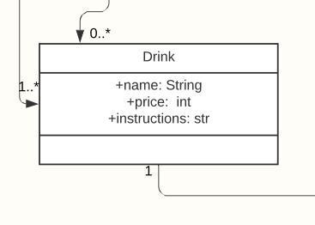
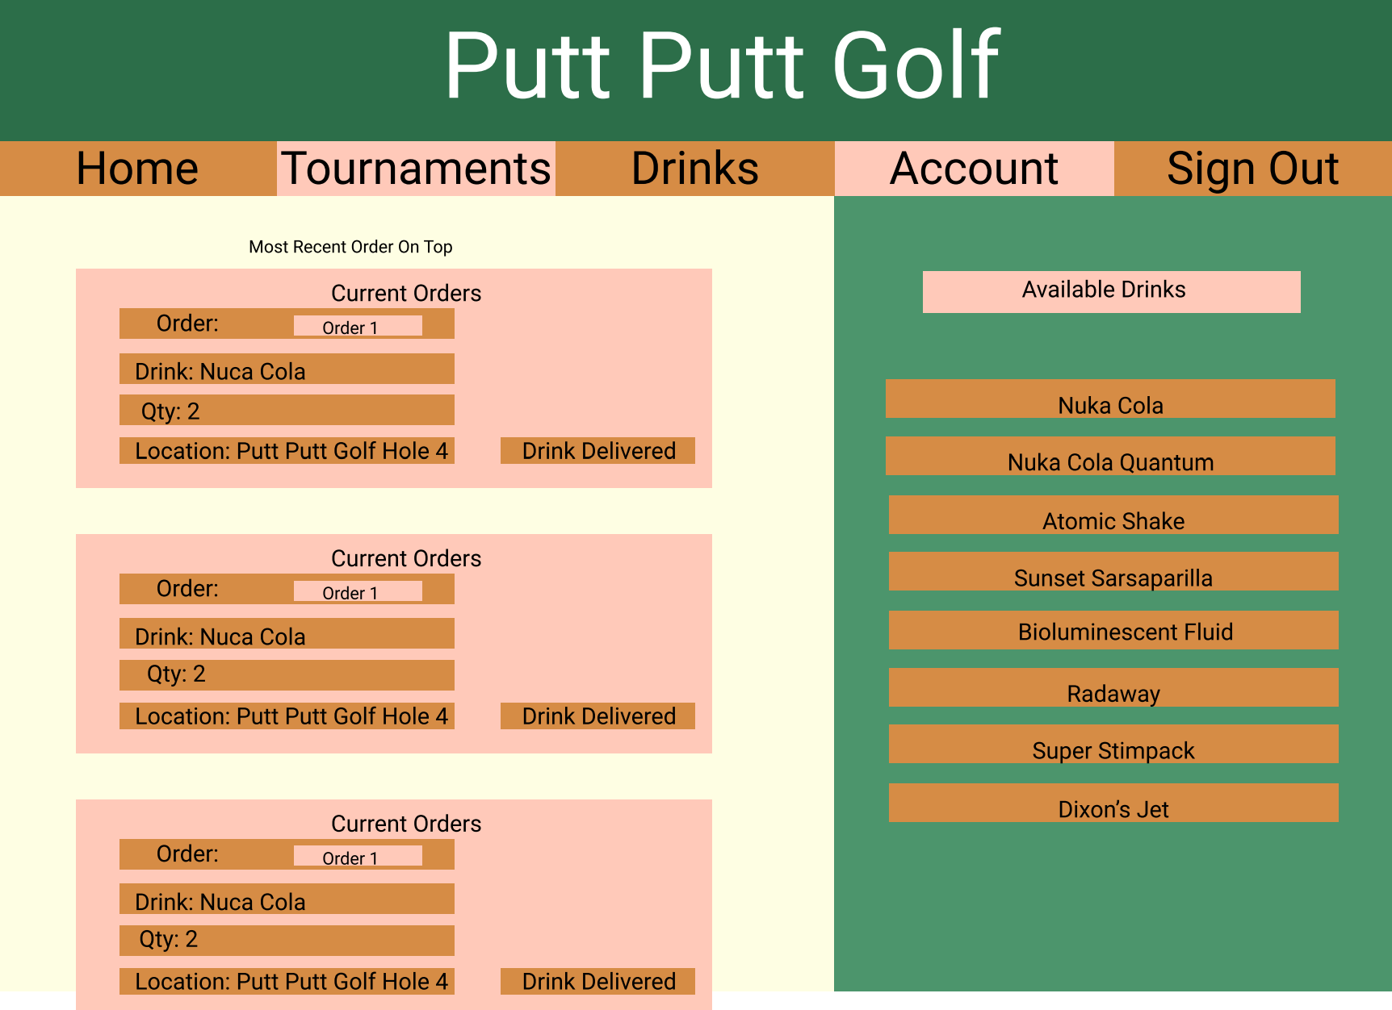
Requirement - Drink Meister
Class Diagrams
Prototype Designs
The drink system implements multiple features and classes. And so the design was broken up into many different parts. The designs related to the Drink Meister were discussed and planned out to fit with rest of the requirements. Assignments were broken up into the following:
Class Diagrams:
Evelyn: Drinks Class, Drink Menu Class, Bank Account Class
Carter: Drink Meister Class
Eathan: Manager Class(Create and edit Drinks)
Activity Diagram:
Evelyn: User Orders a Drink
Prototype Wireframe:
Josh: Drink Edit Page, Drink Meister Page
Lane: Drinks Page, Order Confirmation Page
The prototypes of the drink pages were made to be user friendly. The user can have a reference of the available drinks and then choose among them. The pages were also designed so that the Drink Meister can easily access their employee pages from their account and deliver orders. Once the designs were completed in diagrams and prototypes, they were used and generally followed in the implementation of the Drinks and Drink Meister pages.

Slide 15
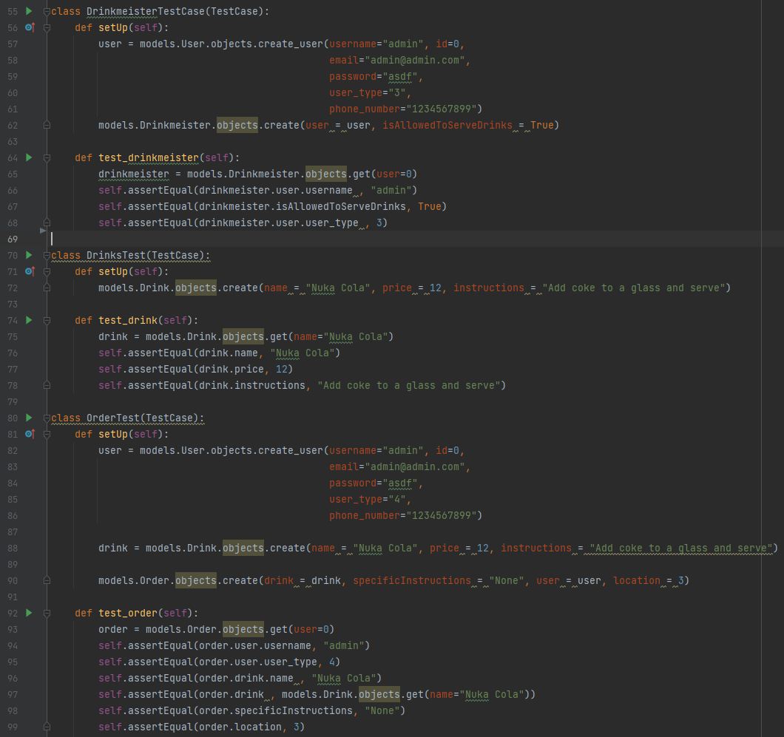
Requirement - Drink Meister
The basic templates for the Drink pages and the django models that they would use, were broken up into assignments for the group. The templates were designed to have some basic functionality first, and then the models were connected when they were completed. The models created a user child class for the Drink Meister. They also had to create drink and order objects that can be created and deleted. These objects had to be able to be used, modified, and stored in the database.
Functional Templates:
Evelyn: Drink Meister Page
Lane: Drinks Page
Josh: Drinks Edit Page, Order Confirmation Page
Model Implementation:
Eathan: Drink Menu Class, Drinks Class, Drink Meister Class, User Class
Carter Manager Class, Bank Account Class
Connecting to Models:
Josh: Drinks Page, Drinks Edit Page, Drink Meister Page
Unit Tests:
Lane: Drink, Order, Drink Meister
The pages were then extensively tested to make sure all the requirement were met. Unit tests were created to test the models and objects. The pages were also tested functionally as part of the development. The Manager has to be able to create and edit drinks. The users have to be able to order drinks if they have the money. The Drink Meister has to be able to see and deliver the orders that were sent. Bug fixes were also part of the development. Examples include fixing when the site couldn’t handle orders from many people or when there were no orders.
Unit Tests

Slide 16
Requirement - Manager Class
Requirements Definition
FURPS
Functionality
There should only be one manager in the system
The manager must be able to verify sponsors and drinkmeisters after their accounts have been created
The manager must receive all the money from tournaments and drink purchases
The manager must be able to edit drinks
Usability
This class will be used by the manager to run the golfing establishment
Performance
Barring poor internet connection, or issues with the AWS server, there should be no performance issues affecting the manager as they use the app
Supportability
This app should be accessible to virtually any device that can use the internet and can display HTML web pages
Audience-oriented
Business Requirements
The manager should be able to run the golfing establishment using this app
User Requirements
The app should be intuitive and require little to no training for new managers to use it
Non-functional Requirements
The interface for the manager should look neat and simple
Functional Requirements
The manager should be able to verify users, receive proceeds from all purchases and tournaments, and be able to modify the selection of drinks available
Implementation Requirements
App should be fully functional locally before it is ported to the AWS server
MOSCOW
Must
The manager must be able to receive money spent on tournaments and on drinks
The manager must be able to edit the selection of drinks available to customers
Should
The manager should be able to verify the accounts of new sponsors and drinkmeisters
Could
The manager could have access to a private drinks menu
Won’t
There won’t be more than 1 manager for the establishment

Slide 17
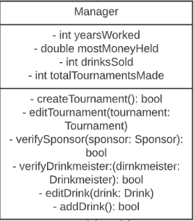
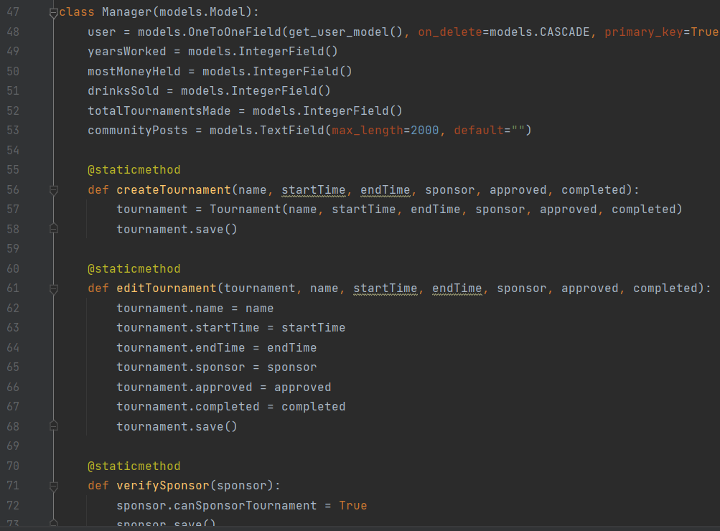
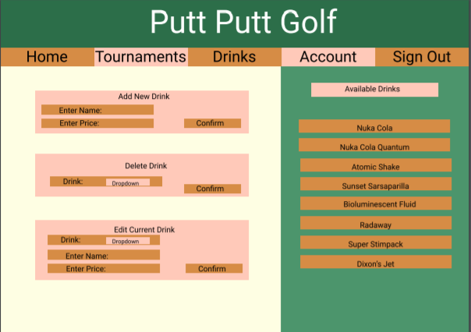
Requirement - Manager Class
Class Diagram
Requirements Definition (Continued)
Excerpt of Manager Implementation
Design Choices
All actions specific to the manager can be found on the manager’s account page.
When the manager picks an action, such as verifying users or editing the drinks menu, the manager is taken to a different page with further options. We did this to avoid having too much content displaying on the account page, making it look cluttered.
Confirmation of whether or not an action is successful is given to the manager for transparency. For example, the manager is notified that they aren’t able to schedule multiple tournaments on the same day if they attempt to do so.
All the manager-specific pages have the same layout and appearance as the rest of the site, keeping the interface simple and intuitive for the manager.
Prototype Drinks Edit Page

Slide 18
Requirement - Manager Class
Scrum Tasks
Developing this feature began with gathering requirements, and these requirements were recorded by Evelyn Teeples.
Next, Eathan Hodgkinson created the class diagram for the manager class based on the requirements
Lane Barnes created the activity diagram for the manager class, and Carter Parks and Eathan Hodgkinson implemented the manager model in Django based on the requirements, class diagram, and activity diagram
Evelyn Teeples then created the prototype account and tournament edit pages for the manager, Josh Williams made the prototype page for editing drinks, and Eathan Hodgkinson made the prototype user verification page
Next, the prototype pages for the manager were linked to the Django models, giving them added functionality. Josh Williams linked the drinks edit page and Eathan Hodgkinson linked the manager account page and the user verification page.
Eathan Hodgkinson and Lane Barnes added the CSS code needed to improve the appearance of all the manager pages
Finally, Eathan Hodgkinson tested the manager page to confirm that all the manager-specific pages work
As of now, all manager-specific pages work except the user verification page, which will be finished at a later date
We tested every feature as it was added
Scrum Tasks Itemized List
Lane Barnes
Created activity diagram for manager
Wrote part of the CSS code for manager pages
Wrote unit tests for the manager class
Eathan Hodgkinson
Created class diagram for manager
Implemented part of the Django manager model
Made prototype user verification page
Linked the manager account and user verification pages to the Django manager model
Wrote part of the CSS code for manager pages
Tested the manager-specific pages for quality assurance
Carter Parks
Implemented part of the Django manager model
Evelyn Teeples
Gathered requirements for manager
Created the prototype account and tournament edit pages
Josh Williams
Made the prototype drinks edit page
Linked the drinks edit page to the Django manager model

Slide 19
Resources
Trello. (2019). https://trello.com
Figma. (2019). https://www.figma.com
Django documentation. (n.d.). https://docs.djangoproject.com/en/3.2/
GitHub. (2013). https://github.com
Lucidchart. (2019). https://www.lucidchart.com
Google Drive. (2019). https://drive.google.com
Discord. (n.d.). https://discord.com/
Amazon Web Services (AWS). (2015). Amazon Web Services, Inc. https://aws.amazon.com
Stack Overflow. (2019). https://stackoverflow.com
Harshvijaythakkar. (2020, December 19). Dajngo [sic] with Nginx, Gunicorn. Analytics Vidhya. https://medium.com/analytics-vidhya/dajngo-with-nginx-gunicorn-aaf8431dc9e0

Slide 20
Questions?

